Slide 1
Progress report
Leo, Sep. 15th, 2021

Slide 2
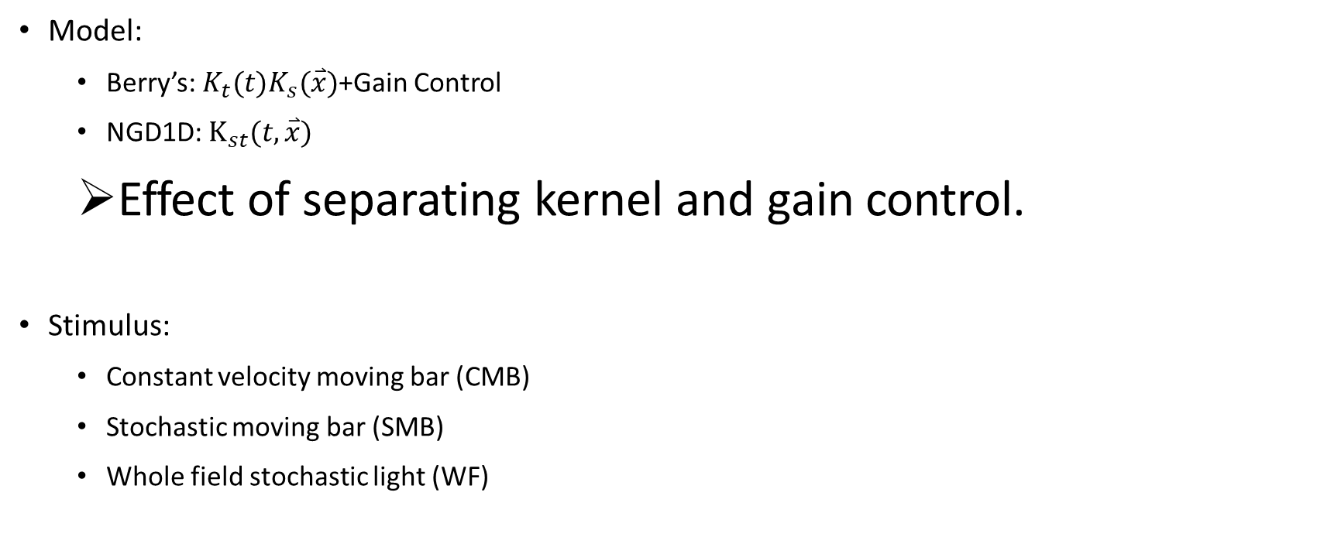
Model:
Berry’s: $K_{t}(t)K_{s}(\overset{⃑}{x})$+Gain Control
NGD1D: $K_{st}(t,\overset{⃑}{x})$
Effect of separating kernel and gain control.
Stimulus:
Constant velocity moving bar (CMB)
Stochastic moving bar (SMB)
Whole field stochastic light (WF)

Slide 3
Model

Slide 4
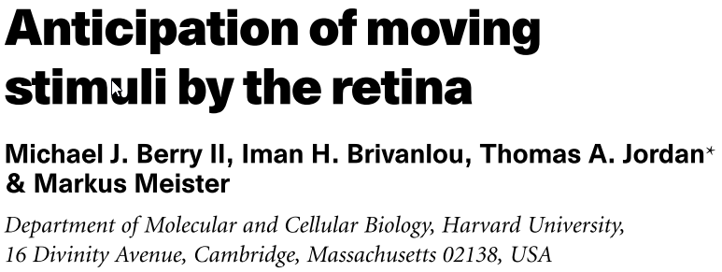
Berry’s Model
Nature, 1999

Slide 5
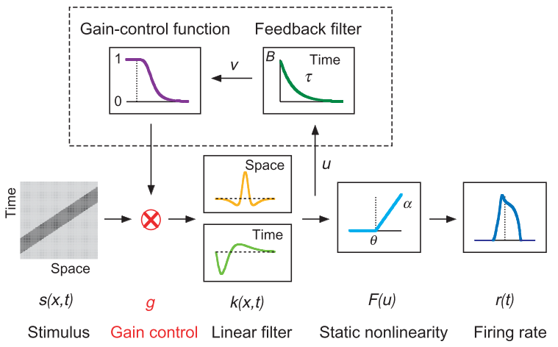
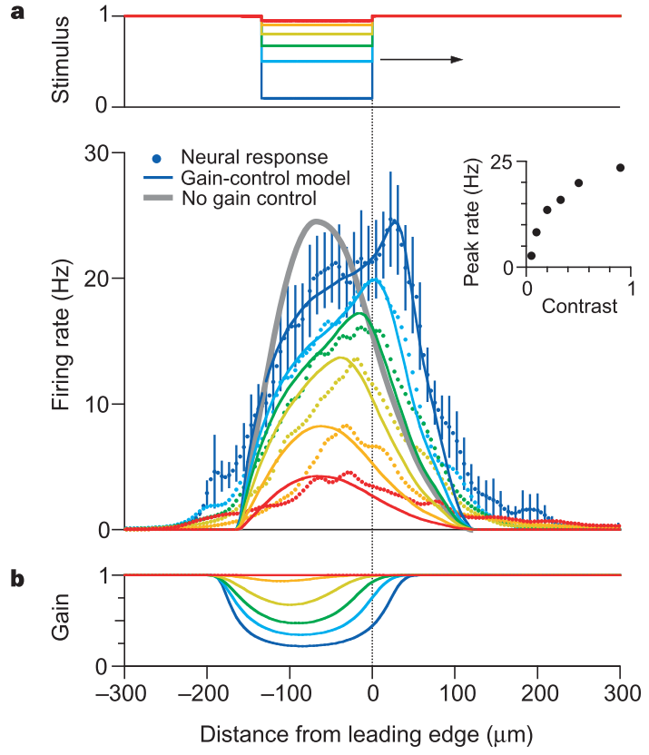
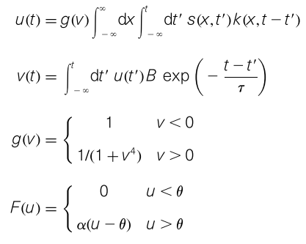

Slide 6
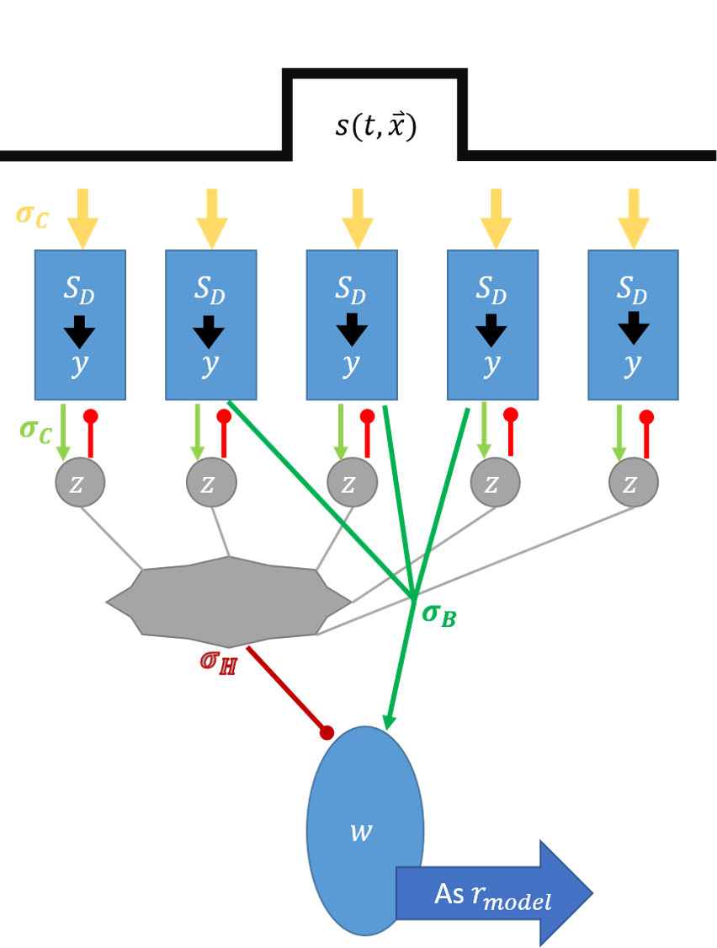
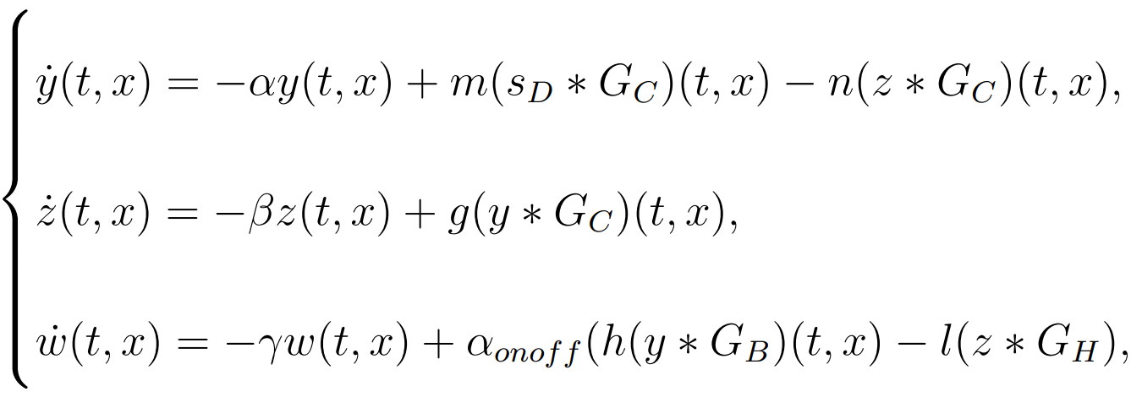
NGD1D model

Slide 7
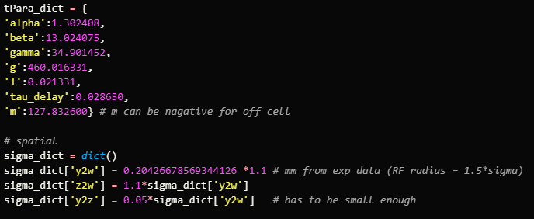

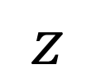

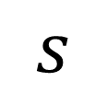
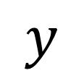
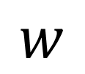
$$s$$
0.05
And a time delay $K_{D}(τ)$
$$y$$
0.05
1
$$z$$
$$δ$$
1.1
$$w$$

Slide 8
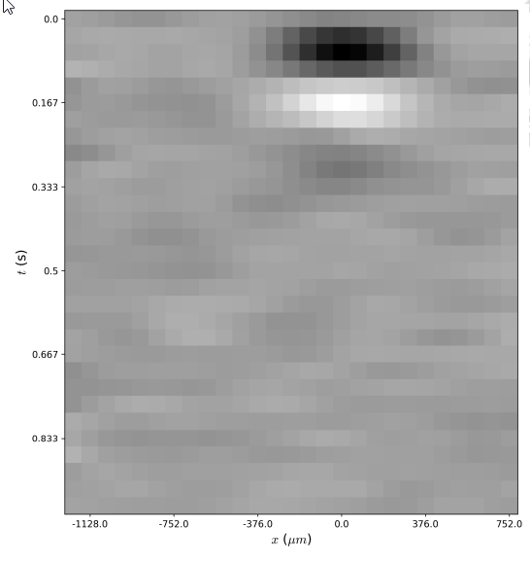
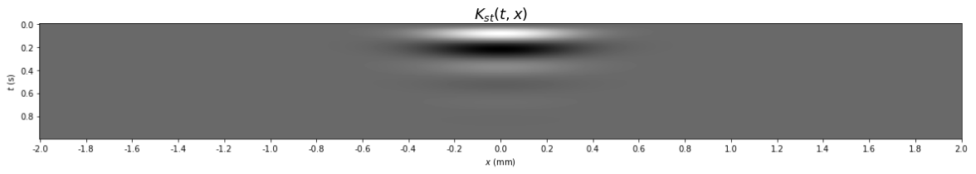
Kernel

Slide 9
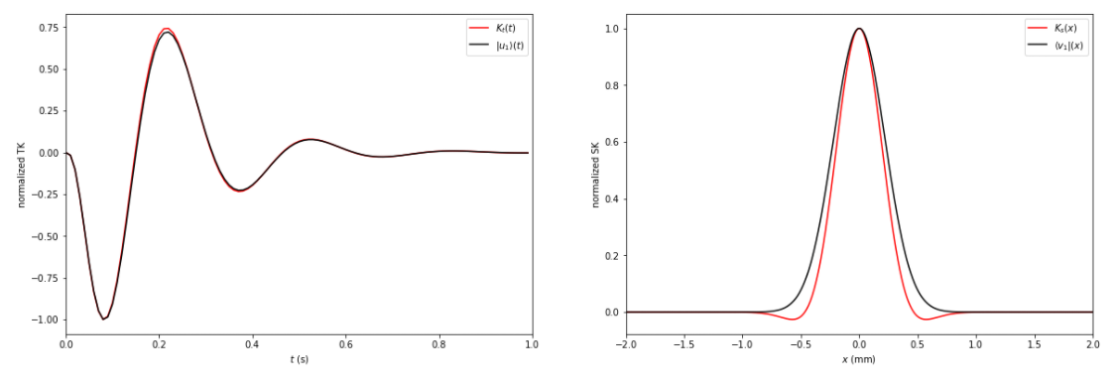
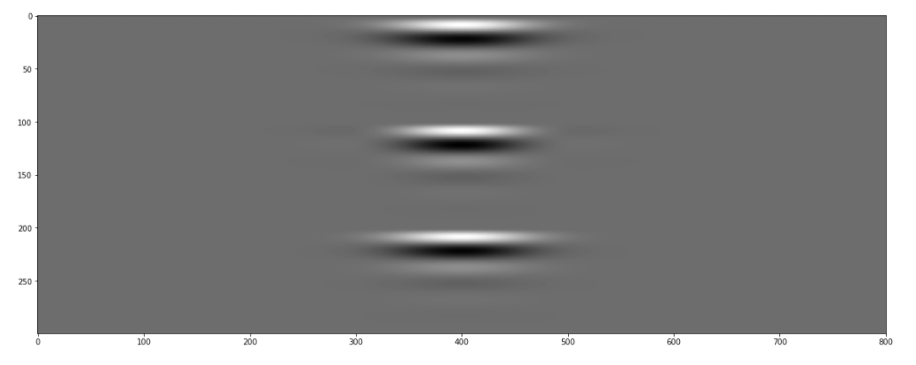
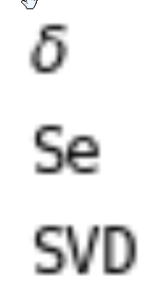



高
Kernel
$$K_{st}$$
$$|\left.K_{s}\right\rangle \left\langle K_{t}\right.|$$
$$σ_{1}|\left.v_{1}\right\rangle \left\langle u_{1}\right.|$$

Slide 10
CMB

Slide 11
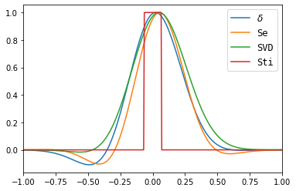
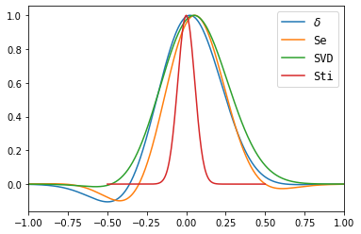
CMB
CMB_specific
v: 0.44 mm/s
Bar width: 0.135 mm
Gaussian σ: 0.053 mm

Slide 12
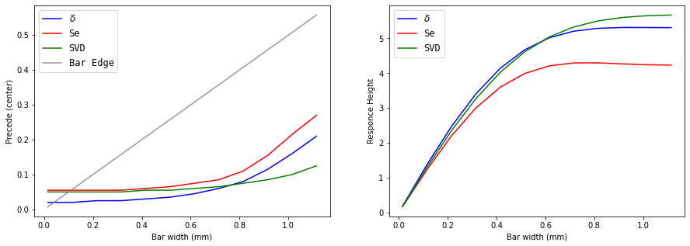
CMB
Bar (square wave) with different width (v: 0.44 mm/s)
CMB_different_width

Slide 13
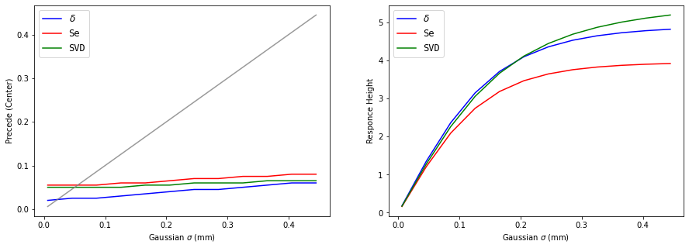
CMB
Gaussian with different σ (v: 0.44 mm/s)
CMB_different_sigma

Slide 14
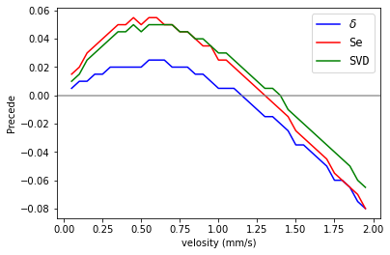
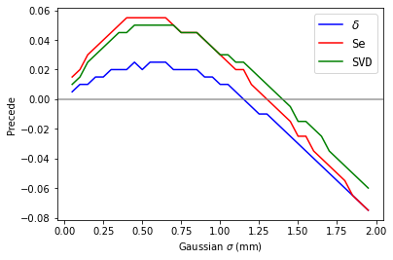
CMB
different v
CMB_different_v
Bar width: 0.135 mm
Gaussian σ: 0.053 mm

Slide 15
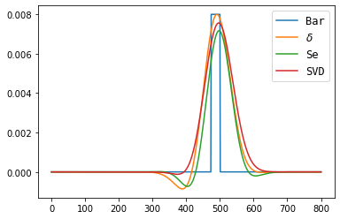

CMB + Gain Control
CMB_GC

Slide 16
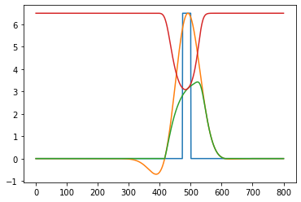
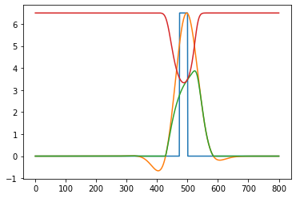
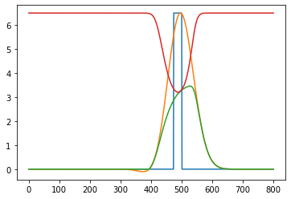
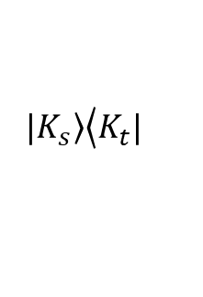
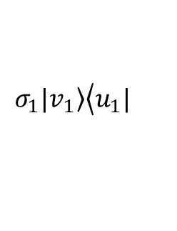

CMB + Gain Control
CMB_GC
$$K_{st}$$
$$|\left.K_{s}\right\rangle \left\langle K_{t}\right.|$$
$$σ_{1}|\left.v_{1}\right\rangle \left\langle u_{1}\right.|$$

Slide 17
SMB

Slide 18
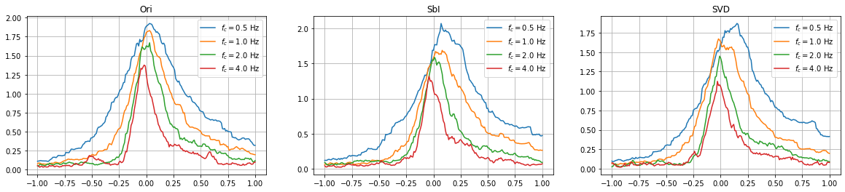

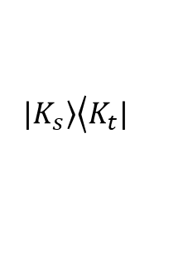
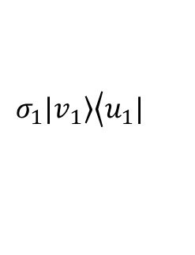
SMB
SMB
MI
$$K_{st}$$
$$|\left.K_{s}\right\rangle \left\langle K_{t}\right.|$$
$$σ_{1}|\left.v_{1}\right\rangle \left\langle u_{1}\right.|$$

Slide 19
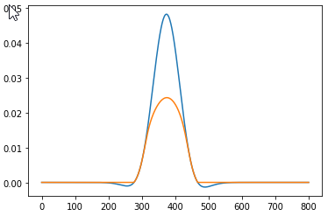
SMB + Gain Control
Response
SMB_GC
Blue: without gain
Orange: with gain

Slide 20
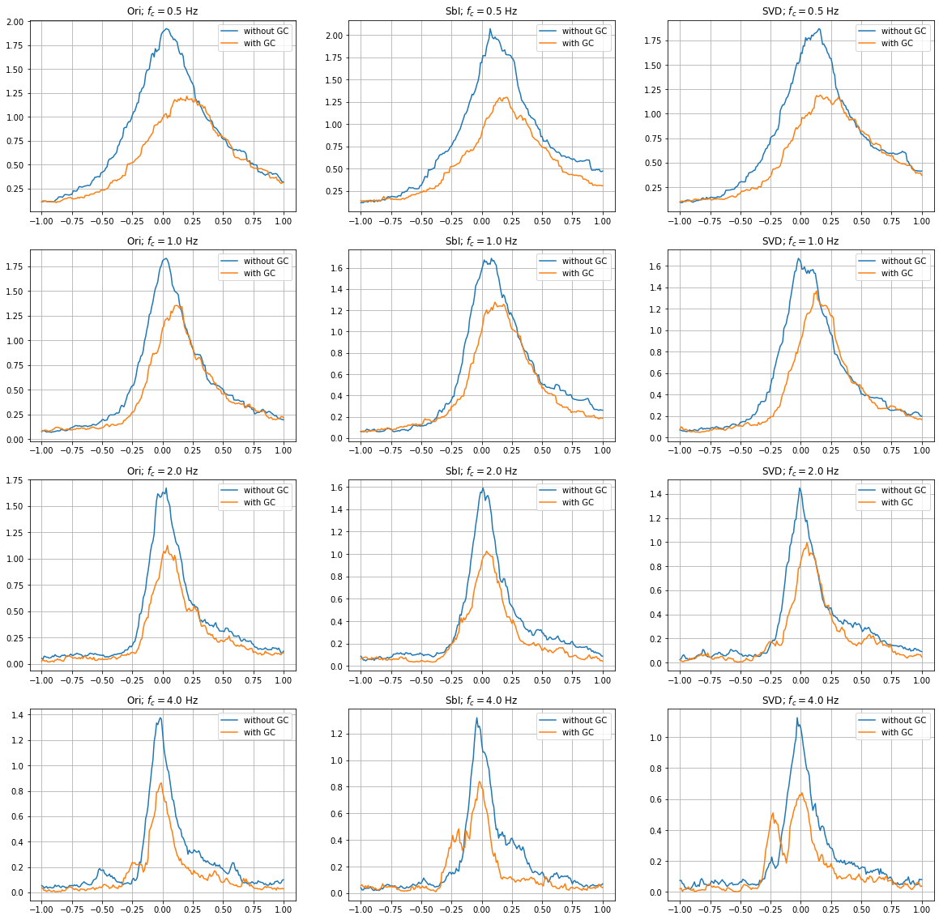
SMB + Gain Control
SMB_GC

Slide 21
WF

Slide 22
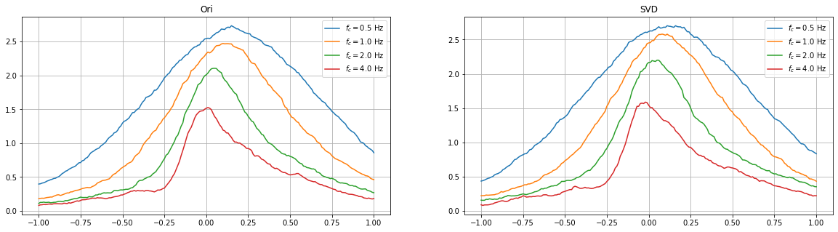
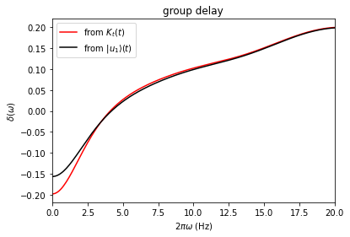
WF
WF

Slide 23
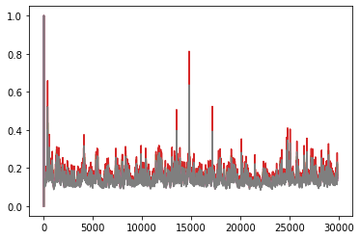
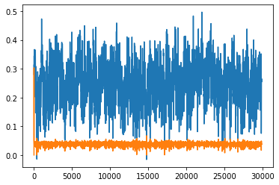
WF + Gain Control
WF_GC
Gains
Responses
Blue: without gain
Orange: with gain
σ μ

Slide 24
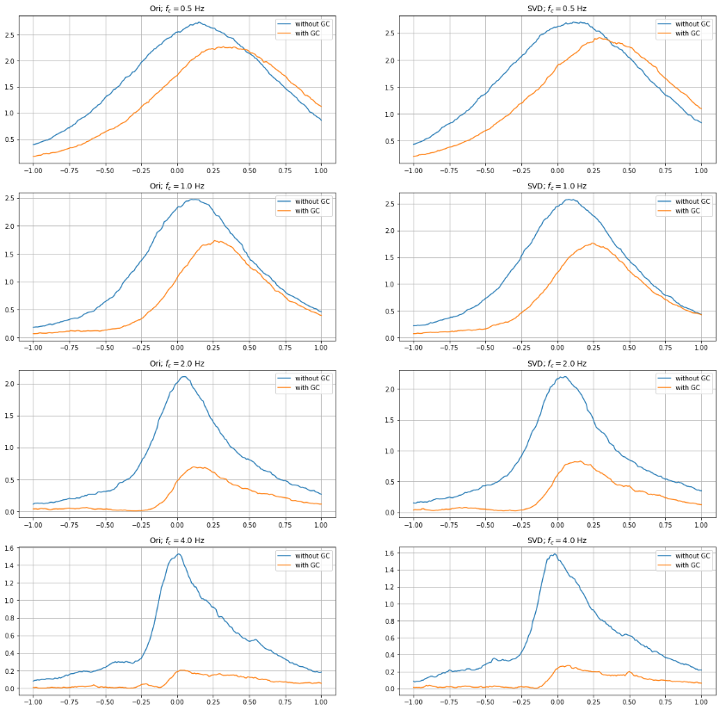
WF + Gain Control
WF_GC

Slide 25
Summary
There are more then ten parameters in NGD1D model, and there are also parameters for gain control. The prediction is highly depend on the set of parameters.
For the set of parameters and the stimuli I set up, the kernel (separable or non-separable) predicts; and the gain control further improves the prediction.

